Slide 1
Chapter 9
Distributed operating system

Slide 2
Introduction
Distributed System is a collection of autonomous computer systems that are physically separated but connected by a centralized computer network equipped with distributed system software.
The autonomous computers will communicate among each system by sharing resources and files and performing the tasks assigned to them.

Slide 3
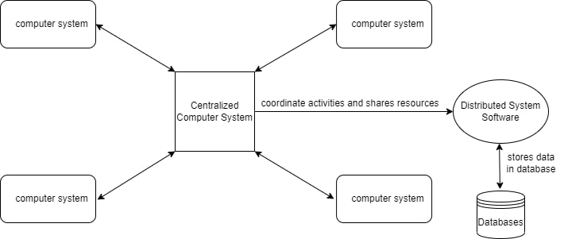
Distributed Operating System

Slide 4
Characteristics of Distributed System:
Resource Sharing: It is the ability to use any Hardware, Software, or Data anywhere in the System.
Openness: It is concerned with Extensions and improvements in the system (i.e., How openly the software is developed and shared with others)
Concurrency: It is naturally present in Distributed Systems, that deal with the same activity or functionality that can be performed by separate users who are in remote locations. Every local system has its independent Operating Systems and Resources.
Scalability: It increases the scale of the system as a number of processors communicate with more users by accommodating to improve the responsiveness of the system.
Fault tolerance: It cares about the reliability of the system if there is a failure in Hardware or Software, the system continues to operate properly without degrading the performance the system.
Transparency: It hides the complexity of the Distributed Systems to the Users and Application programs as there should be privacy in every system.
Heterogeneity: Networks, computer hardware, operating systems, programming languages, and developer implementations can all vary and differ among dispersed system components.

Slide 5
Advantages of Distributed System:
Information in Distributed Systems is shared among geographically distributed users.
Resource Sharing (Autonomous systems can share resources from remote locations).
It has a better price performance ratio and flexibility.
It has shorter response time and higher throughput.
It has higher reliability and availability against component failure.
It has extensibility so that systems can be extended in more remote locations and also incremental growth.

Slide 6
Disadvantages of Distributed System:
Relevant Software for Distributed systems does not exist currently.
Security possess a problem due to easy access to data as the resources are shared to multiple systems.
Networking Saturation may cause a hurdle in data transfer i.e., if there is a lag in the network then the user will face a problem accessing data.
In comparison to a single user system, the database associated with distributed systems is much more complex and challenging to manage.
If every node in a distributed system tries to send data at once, the network may become overloaded.

Slide 7
Network operating system(NOS)
A network operating system(NOS) is software that connects multiple devices and computers on the network and allows them to share resources on the network.
Functions of the network operating system.
Creating and managing user accounts on the network.
Controlling access to resources on the network.
Provide communication services between the devices on the network.
Monitor and troubleshoot the network.
Configuring and Managing the resources on the network.

Slide 8
Types of Network operating systems
Peer to Peer
Peer-to-peer network operating systems allow sharing resources and files with small-sized networks and having fewer resources.
In general, peer-to-peer network operating systems are used on LAN.
2. Client/server Client-server network operating systems provide users access to resources through the central server.
This no is too expensive to implement and maintain.
This operating system is good for the big networks which provide many services.

Slide 9
Advantages of Network operating systems :
Highly stable due to central server.
Provide good security.
Upgradation of new technology and hardware can be easily implemented in the network.
Provide remote access to servers from different locations.

Slide 10
Disadvantages of Network operating systems :
Depend on the central location to perform the operations.
High cost to buying server.
Regular updating and maintenance are required.

Slide 11
Examples of Network Operating systems :
Following are the examples of network operating systems.
Microsoft Windows Server
UNIX/Linux
Artisoft’s LANtastic
Banyan’s VINES

Slide 12
Key | Network OS | Distributed OS
Objective | It provides local services to remote clients. | It manages the hardware resources.
Communication | Communication is file-based, shared folder based. | Communication is message-based or shared memory-based.
Scalability | Network OS is highly scalable. A new machine can be added very easily. | Distributed OS is less scalable. The process to add new hardware is complex.
Fault tolerance | Less fault tolerance as compared to distributed OS. | It has very high fault tolerance.
Autonomy | Each machine can acts on its own thus autonomy is high. | It has a poor rate of autonomy
Implementation | Network OS-based systems are easy to build and maintain. | It is difficult to implement a Distributed OS.
Operating System | Network OS-based systems have their own copy of operating systems. | Distributed OS-based nodes have the same copy of the operating system.

Slide 13
Hardware and software concepts
All distributed system consists of multiple CPUs.
There are several different ways the hardware can be arranged.
An important thing that is concerned about hardware is how they are interconnected and how they communicate with each other.
Many classification schemes for multiple CPUs have been proposed.
Commonly used taxonomy is Flynn’s taxonomy.

Slide 14
Flynn's classification divides computers into four major groups that are
Single instruction stream, single data stream (SISD)
Single instruction stream, multiple data stream (SIMD)
Multiple instruction streams, single data stream (MISD)
Multiple instruction streams, multiple data stream (MIMD)

Slide 15
Single Instruction Single Data
SISD stands for 'Single Instruction and Single Data Stream'. It represents the organization of a single computer containing a control unit, a processor unit, and a memory unit.
Instructions are executed sequentially, and the system may or may not have internal parallel processing capabilities.
Most conventional computers have SISD architecture like the traditional Von-Neumann computers.

Slide 16
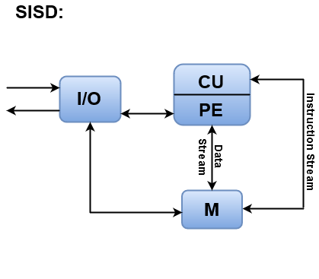
Single Instruction Single Data

Slide 17
Single Instruction and Multiple Data Stream
SIMD stands for 'Single Instruction and Multiple Data Stream'. It represents an organization that includes many processing units under the supervision of a common control unit.
All processors receive the same instruction from the control unit but operate on different items of data.
The shared memory unit must contain multiple modules so that it can communicate with all the processors simultaneously.

Slide 18
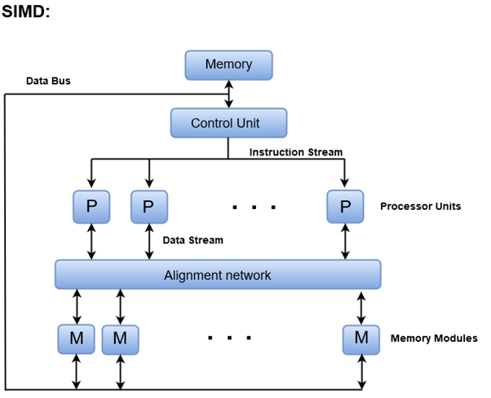
Single Instruction and Multiple Data Stream

Slide 19
Multiple Instruction and Single Data stream
MISD structure is only of theoretical interest since no practical system has been constructed using this organization.
In MISD, multiple processing units operate on one single-data stream. Each processing unit operates on the data independently via separate instruction stream.

Slide 20
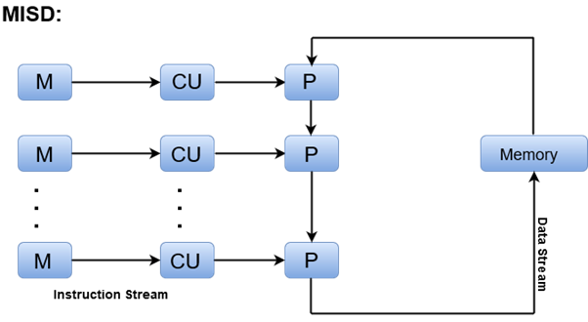
Multiple Instruction and Single Data stream

Slide 21
Multiple Instruction and Multiple Data Stream
In this organization, all processors in a parallel computer can execute different instructions and operate on various data at the same time.
In MIMD, each processor has a separate program and an instruction stream is generated from each program.

Slide 22
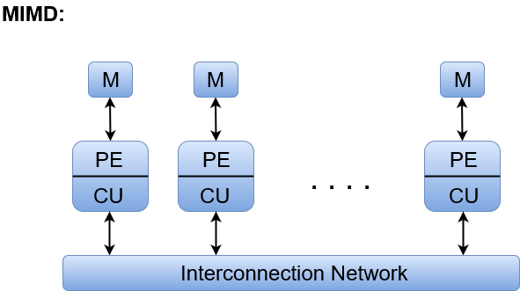
Multiple Instruction and Multiple Data Stream

Slide 23
Communication In Distributed System
Two approaches for communication in a distributed system.
Shared Memory
Message Passing

Slide 24
1. Shared Memory
DSM is a mechanism that manages memory across multiple nodes and makes inter-process communications transparent to end-users.
The distributed shared memory (DSM) implements the shared memory model in distributed systems but it doesn’t have physical shared memory.
All the nodes share the virtual address space provided by the shared memory model. The Data moves between the main memories of different nodes.

Slide 25
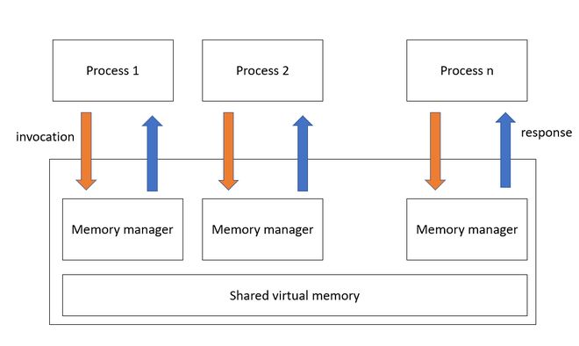
Shared Memory

Slide 26
Advantages of Distributed shared memory
Programmer need not concern about data movement, As the address space is the same it is easier to implement than Remote Procedure Call.
DSM programs are portable as they use a common programming interface.
Data moved in large blocks i.e. data near to the current memory location that is being fetched, may be needed future so it will be also fetched.
It provides large virtual memory space, the total memory size is the sum of the memory size of all the nodes, paging activities are reduced.
They can join and leave DSM system without affecting the others as there is no need for sender and receiver to existing,
They all share the address space so one process can easily be moved to a different machine.

Slide 27
2. Message Passing
Message passing is the interaction of exchanging messages between at least two processors.
The cycle which is sending the message to one more process is known as the sender and the process which is getting the message is known as the receiver.
In a message-passing system, we can send the message by utilizing send function and we can receive the message by utilizing receive function.
Following are the general syntaxes for send function and receive function.
Send()
Receive()
Send (receiver, message)
Receive(sender, message)

Slide 28
3. A Remote Procedure Call
A remote procedure call is a strong procedure for building distributed client server-based applications.
In RPC there is a compelling reason need to change every one of the processors in an equivalent memory area or address space.
RPC is utilized fully to communicate the processors at whatever point they are in the various memory area. In the same system or in a different system in the distributed system.
RPC is generally helpful for developing client server-based applications.
The process which needs to access the service is known as the client cycle or “caller”. The process which provides the services is known as the server process, or “callee”.

Slide 29
Clock Synchronization
Distributed System is a collection of computers connected via a high-speed communication network.
In the distributed system, the hardware and software components communicate and coordinate their actions by message passing.
Each node in distributed systems can share its resources with other nodes.
So, there is a need for proper allocation of resources to preserve the state of resources and help coordinate between the several processes.

Slide 30
Clock Synchronization
To resolve such conflicts, synchronization is used. Synchronization in distributed systems is achieved via clocks.
The physical clocks are used to adjust the time of nodes. Each node in the system can share its local time with other nodes in the system.
The time is set based on UTC (Universal Time Coordination).
UTC is used as a reference time clock for the nodes in the system.

Slide 31
Clock synchronization can be achieved by 2 ways: External and Internal Clock Synchronization.
External clock synchronization is the one in which an external reference clock is present. It is used as a reference and the nodes in the system can set and adjust their time accordingly.
Internal clock synchronization is the one in which each node shares its time with other nodes and all the nodes set and adjust their times accordingly.

Slide 32
There are 2 types of clock synchronization algorithms: Centralized and Distributed.
1. Centralized is the one in which a time server is used as a reference. The single time-server propagates it’s time to the nodes, and all the nodes adjust the time accordingly.
It is dependent on a single time-server, so if that node fails, the whole system will lose synchronization.
Examples of centralized are-Berkeley the Algorithm, Passive Time Server, Active Time Server, etc.
2.Distributed is the one in which there is no centralized time-server present. Instead, the nodes adjust their time by using their local time and then, taking the average of the differences in time with other nodes.
Distributed algorithms overcome the issue of centralized algorithms like scalability and single point failure.
Examples of Distributed algorithms are – Global Averaging Algorithms, Localized Averaging Algorithm, NTP (Network time protocol), etc.

